Slide 1

A Novel Approach of Generating Electricity using Staircase featuring Piezoelectric Patches and DC Alternator

Slide 2

Our inspiration and idea
Chandigarh university has around 30,000 students studying. Each day thousands of student climb stairs up and down, that’s a huge amount of Energy.
So, we thought why don’t we store and utilize it ?
Our research was mainly emphasized on how can we transform the energy of the students while climbing stairs to electricity which can be used for numerous applications.

Slide 3
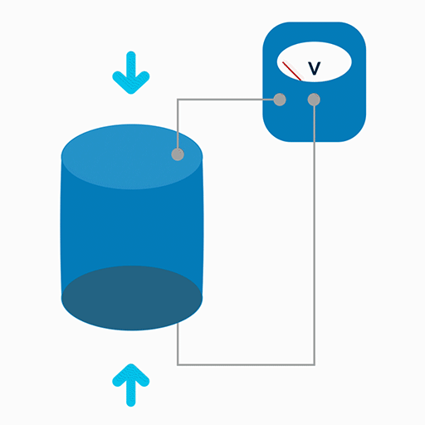
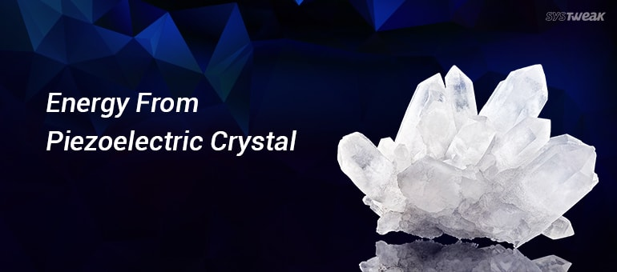
How we will do it?
The answer lies in science!
A concept commonly known as PIEZOELECTRIC BEHAVIOUR.
This behavior is caused due to some complex chemistry formations in materials at their atomic level.

Slide 4
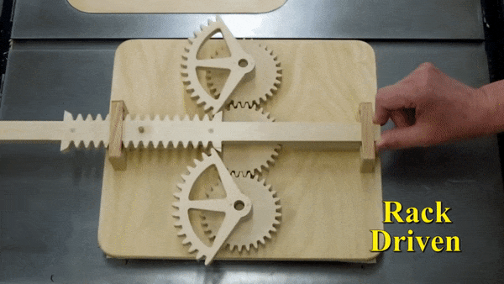
Not just piezoelectric, we are also adding
up a new methodology in the process to
maximize and enhance the output.
We are using unidirectional, linear to
rotary motion mechanism in which the
resorting motion of the rack will be
done by springs.

Slide 5
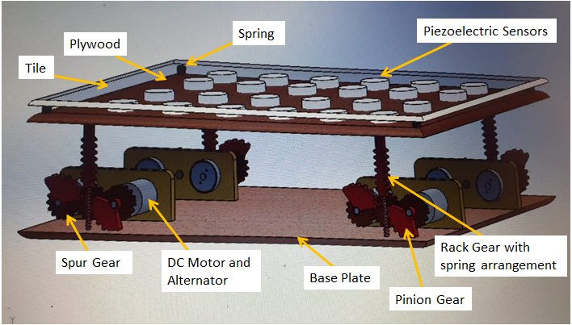
Our Prototype

Slide 6
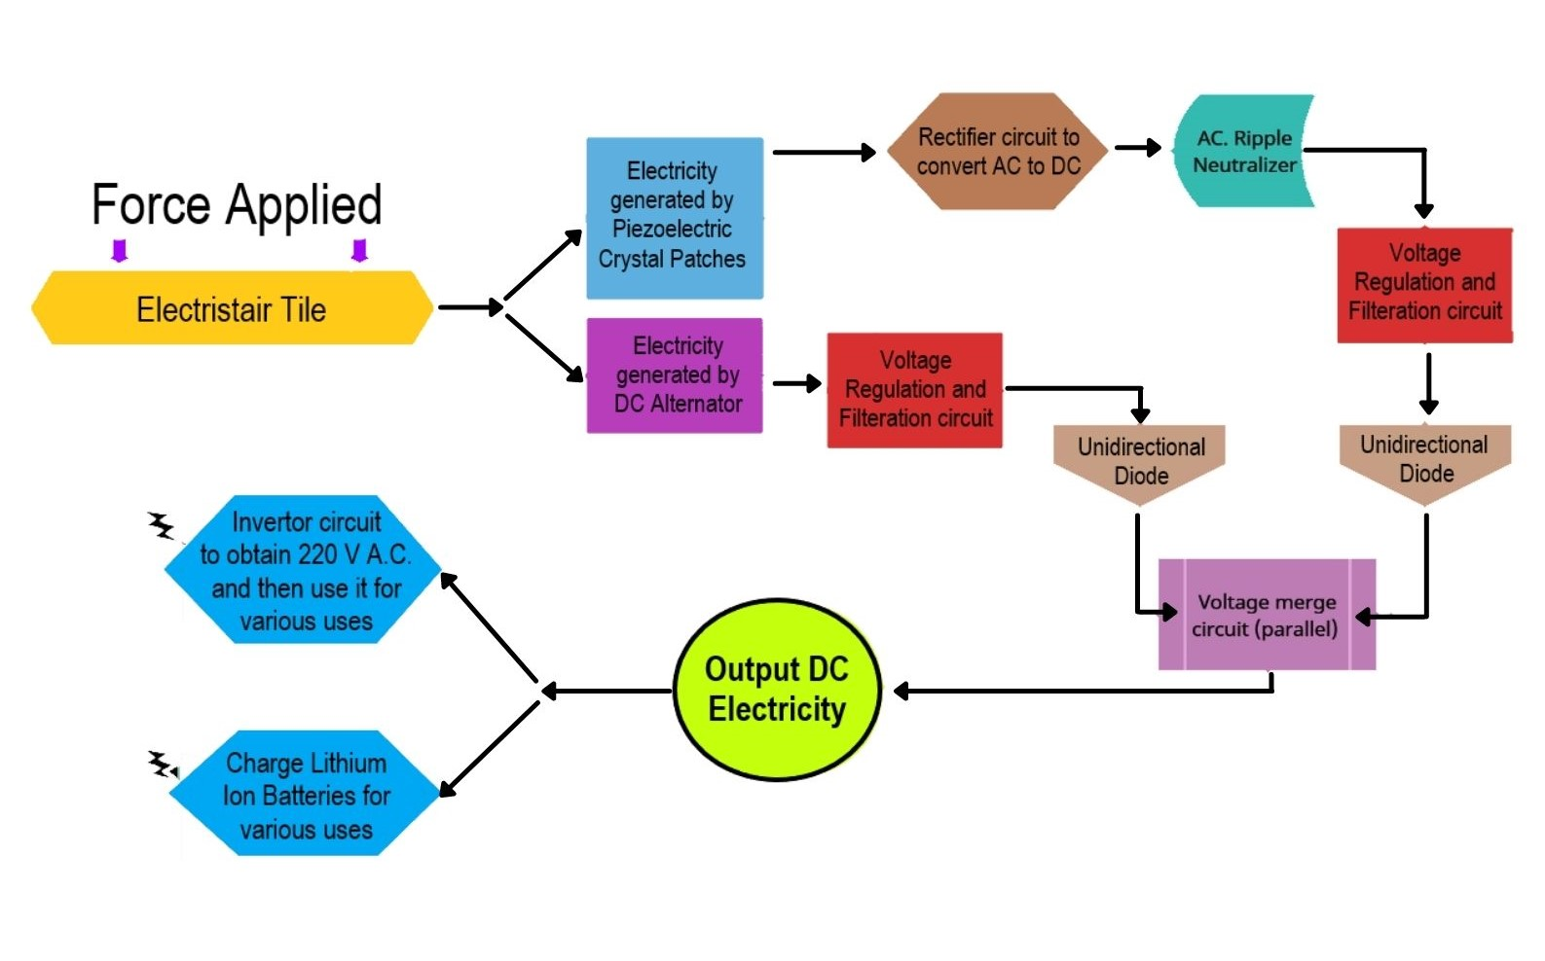
Block Diagram

Slide 7

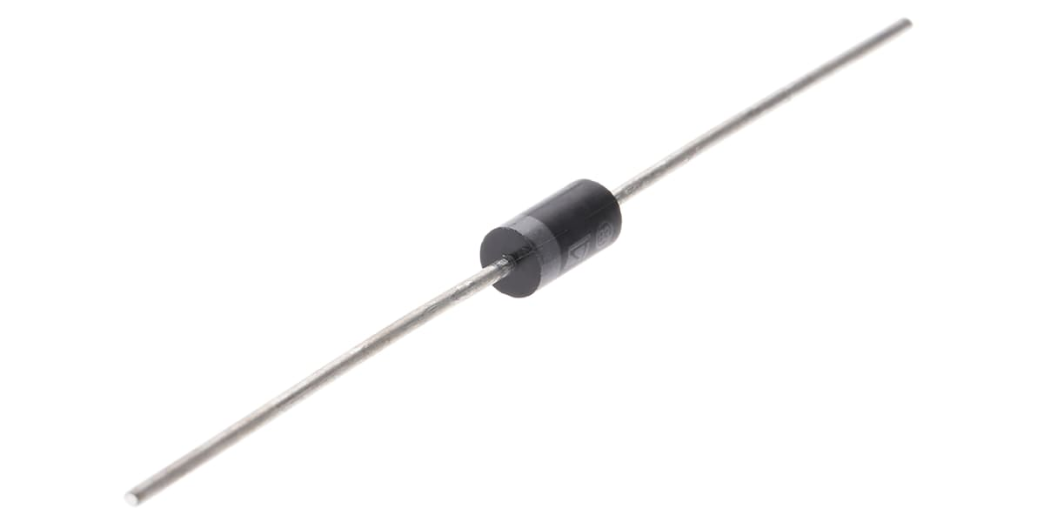
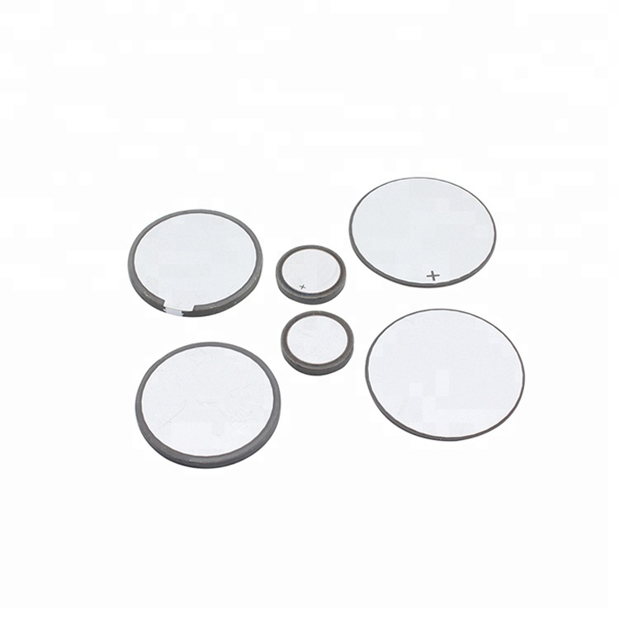
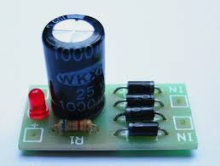
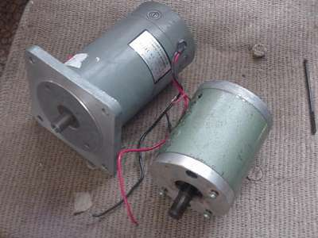
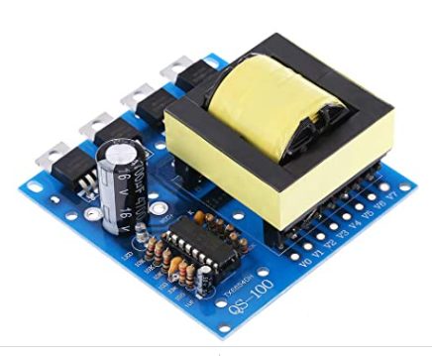
Components used
Voltage Regulator Diode Piezoelectric patches
Rectifier Circuit
DC Alternator
DC to AC Converter

Slide 8


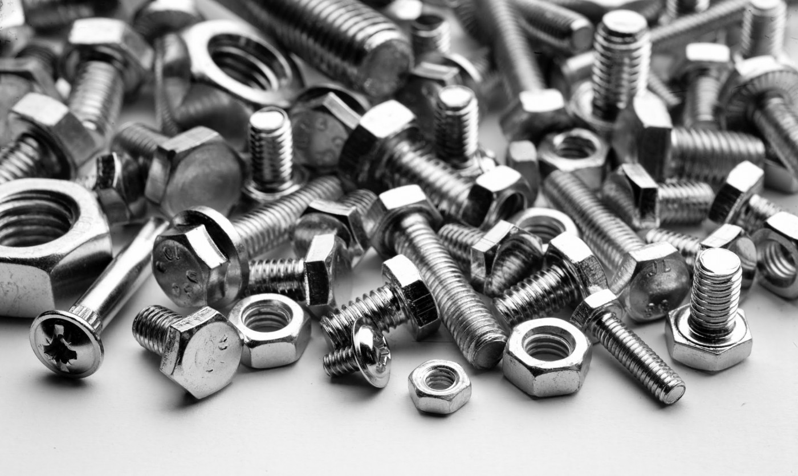

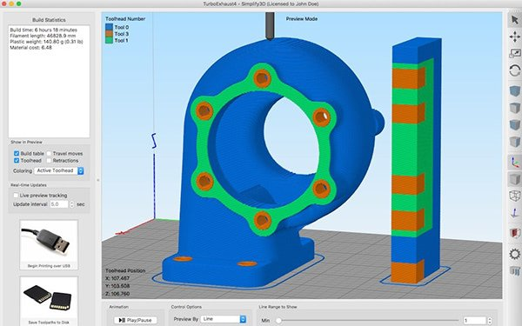
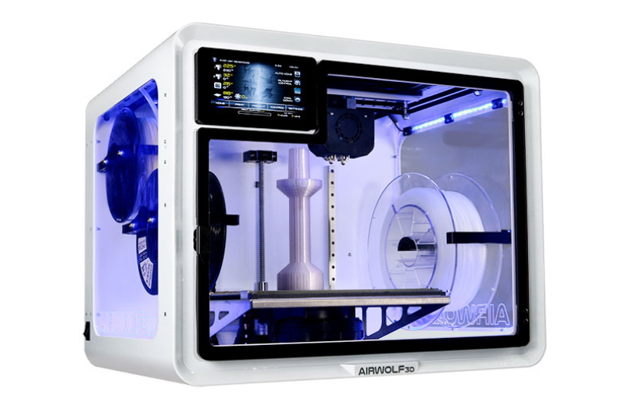
Tools used
Soldering tools
Rotary tools
Nuts, screws and bolts
Super Glue
Design and Simulation tool
Rapid prototyping tools

Slide 9
Our Future Vision
Through this research and development journey, we have tried taking our first step towards generating clean and sustainable energy considering the fact that most of the energy was getting wasted while climbing up stairs. We are looking forward to increase the efficiency of our current system so as to harvest the maximum amount of energy possible which can be used to meet the growing demand of electricity in the near future.

Slide 10
Conclusion
In this paper, we discussed the novel approach of electricity generation from staircase using piezoelectric crystal and DC alternator. The objective of this research work is to generate clean and eco-friendly electrical energy without compromising the reliability and safety of traditional stairs. The main motive is to trap the energy of people which is being wasted while using the stairs and after it’s processing which we have shown in design implementation section, we get smooth 12 volts output which can be utilised as per any electric requirements. The energy source form each stair is in continuous and renewable form. Moreover, it ensures that this method of power generation will be beneficial for rural electrification and fulfil our power requirements of future cities.

Slide 11


THANK
YOU !

